Slide 1
S2-19_DSECLZC415 CLUSTERING
JULY 11 – Dr.D.VENKATA SUBRAMANIAN
Slide Courtesy: Prof. T.V. Rao

Slide 2

The slides presented here are obtained from the authors of the books and from various other contributors. I hereby acknowledge all the contributors for their material and inputs.
I have added and modified a few slides to suit the requirements of the course.

Slide 3
What is Cluster Analysis?
Finding groups of objects such that the objects in a group will be similar (or related) to one another and different from (or unrelated to) the objects in other groups
Inter-cluster distances are maximized
Intra-cluster distances are minimized
CLUSTER ANALYSIS IS ALSO CALLED DATA SEGMENTATION.
IT IS AN EXPLOARATORY METHOD FOR IDENTIFYING HOMOGENOUS GROUPS OR CLUSTERS OF RECORDS.
SIMILAR RECORDS SHOULD BELONG TO THE SAME CLUSTER
DISSIMILAR RECORDS SHOULD BELONG TO DIFFERENT CLUSTER

Slide 4
Examples of Clustering Applications
Marketing: Help marketers discover distinct groups in their customer bases, and then use this knowledge to develop targeted marketing programs
Land use: Identification of areas of similar land use in an earth observation database
Insurance: Identifying groups of motor insurance policy holders with a high average claim cost
City-planning: Identifying groups of houses according to their house type, value, and geographical location
Earth-quake studies: Observed earth quake epicenters should be clustered along continent faults

Slide 5
What is not Cluster Analysis?
Supervised classification
Have class label information
Simple segmentation
Dividing students into different registration groups alphabetically, by last name
Results of a query
Groupings are a result of an external specification

Slide 6
Quality: What Is Good Clustering?
A good clustering method will produce high quality clusters with
high intra-class similarity
low inter-class similarity
The quality of a clustering result depends on both the similarity measure used by the method and its implementation
The quality of a clustering method is also measured by its ability to discover some or all of the hidden patterns

Slide 7
Measure the Quality of Clustering
Dissimilarity/Similarity metric: Similarity is expressed in terms of a distance function, typically metric: d(i, j)
There is a separate “quality” function that measures the “goodness” of a cluster.
The definitions of distance functions are usually very different for interval-scaled, boolean, categorical, ordinal ratio, and vector variables.
Weights should be associated with different variables based on applications and data semantics.
It is hard to define “similar enough” or “good enough”
the answer is typically highly subjective.

Slide 8
Requirements of Clustering in Data Mining
Scalability
Ability to deal with different types of attributes
Ability to handle dynamic data
Discovery of clusters with arbitrary shape
Minimal requirements for domain knowledge to determine input parameters
Able to deal with noise and outliers
Insensitive to order of input records
High dimensionality
Incorporation of user-specified constraints
Interpretability and usability

Slide 9
Type of data in clustering analysis
Interval-scaled variables
Binary variables
Nominal, ordinal, and ratio variables
Variables of mixed types

Slide 10
Interval-valued variables
Standardize data
Calculate the mean absolute deviation:
where
Calculate the standardized measurement (z-score)
Using mean absolute deviation is more robust than using standard deviation

Slide 11
Similarity and Dissimilarity Between Objects
Distances are normally used to measure the similarity or dissimilarity between two data objects
Some popular ones include: Minkowski distance:
where i = (x_{i1}, x_{i2}, …, x_{ip}) and j = (x_{j1}, x_{j2}, …, x_{jp}) are two p-dimensional data objects, and q is a positive integer
If q = 1, d is Manhattan distance

Slide 12
Similarity and Dissimilarity Between Objects (Cont.)
If q = 2, d is Euclidean distance:
Properties
d(i,j) ≥ 0
d(i,i) = 0
d(i,j) = d(j,i)
d(i,j) ≤ d(i,k) + d(k,j)
Also, one can use weighted distance, parametric Pearson product moment correlation, or other dissimilarity measures

Slide 13
Binary Variables
A contingency table for binary data
Distance measure for symmetric binary variables:
Distance measure for asymmetric binary variables:
Jaccard coefficient (similarity measure for asymmetric binary variables):
Object j
Object i

Slide 14
Nominal Variables
A generalization of the binary variable in that it can take more than 2 states, e.g., red, yellow, blue, green
Method 1: Simple matching
m: # of matches, p: total # of variables
Method 2: use a large number of binary variables
creating a new binary variable for each of the M nominal states

Slide 15
Ordinal Variables
An ordinal variable can be discrete or continuous
Order is important, e.g., rank
Can be treated like interval-scaled
replace x_{if} by their rank
map the range of each variable onto [0, 1] by replacing i-th object in the f-th variable by
compute the dissimilarity using methods for interval-scaled variables

Slide 16
Notion of a Cluster can be Ambiguous
How many clusters?
Six Clusters
Two Clusters
Four Clusters

Slide 17
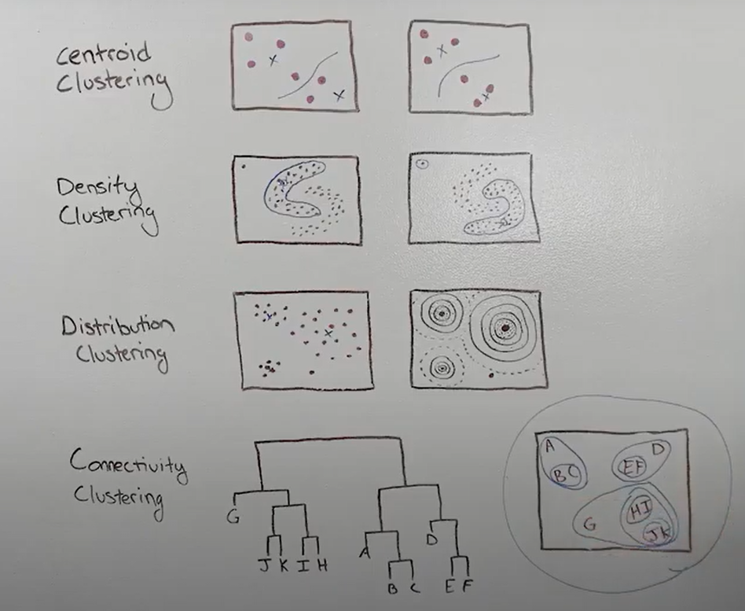
Types of Clusterings
A clustering is a set of clusters
An important distinction among types of clustering : hierarchical and partitional sets of clusters
Partitional Clustering
A division data objects into non-overlapping subsets (clusters) such that each data object is in exactly one subset
Hierarchical clustering
A set of nested clusters organized as a hierarchical tree

Slide 18
Partitional Clustering
Original Points
A Partitional Clustering

Slide 19
Hierarchical Clustering
Traditional Hierarchical Clustering
Traditional Dendrogram
Non-traditional Hierarchical Clustering
Non-traditional Dendrogram

Slide 20
Other Distinctions Between Sets of Clusters
Exclusive versus non-exclusive
In non-exclusive clustering, points may belong to multiple clusters.
Can represent multiple classes or ‘border’ points
Fuzzy versus non-fuzzy
In fuzzy clustering, a point belongs to every cluster with some weight between 0 and 1
Weights must sum to 1
Probabilistic clustering has similar characteristics
Partial versus complete
In some cases, we only want to cluster some of the data
Heterogeneous versus homogeneous
Cluster of widely different sizes, shapes, and densities

Slide 21
Types of Clusters
Clusters can be of many types:
Well-separated clusters
Center-based clusters
Contiguous clusters
Density-based clusters
Property or Conceptual
Described by an Objective Function

Slide 22
Types of Clusters: Well-Separated
Well-Separated Clusters:
A cluster is a set of points such that any point in a cluster is closer (or more similar) to every other point in the cluster than to any point not in the cluster.
3 well-separated clusters

Slide 23
Types of Clusters: Center-Based
Center-based
A cluster is a set of objects such that an object in a cluster is closer (more similar) to the “center” of a cluster, than to the center of any other cluster
The center of a cluster is often a centroid, the average of all the points in the cluster, or a medoid, the most “representative” point of a cluster
4 center-based clusters

Slide 24
Types of Clusters: Contiguity-Based
Contiguous Cluster (Nearest neighbor or Transitive)
A cluster is a set of points such that a point in a cluster is closer (or more similar) to one or more other points in the cluster than to any point not in the cluster.
8 contiguous clusters

Slide 25
Types of Clusters: Density-Based
Density-based
A cluster is a dense region of points, which is separated by low-density regions, from other regions of high density.
Used when the clusters are irregular or intertwined, and when noise and outliers are present.
6 density-based clusters

Slide 26
Types of Clusters: Conceptual Clusters
Shared Property or Conceptual Clusters
Finds clusters that share some common property or represent a particular concept.
.
2 Overlapping Circles

Slide 27
Types of Clusters: Objective Function
Clusters Defined by an Objective Function
Finds clusters that minimize or maximize an objective function.
Enumerate all possible ways of dividing the points into clusters and evaluate the `goodness' of each potential set of clusters by using the given objective function. (NP Hard)
Can have global or local objectives.
Hierarchical clustering algorithms typically have local objectives
Partitional algorithms typically have global objectives
A variation of the global objective function approach is to fit the data to a parameterized model.
Parameters for the model are determined from the data.
Mixture models assume that the data is a ‘mixture' of a number of statistical distributions.

Slide 28
Types of Clusters: Objective Function …
Map the clustering problem to a different domain and solve a related problem in that domain
Proximity matrix defines a weighted graph, where the nodes are the points being clustered, and the weighted edges represent the proximities between points
Clustering is equivalent to breaking the graph into connected components, one for each cluster.
Want to minimize the edge weight between clusters and maximize the edge weight within clusters

Slide 29
Important Characteristics of the Input Data
Type of proximity or density measure
This is a derived measure, but central to clustering
Sparseness
Dictates type of similarity
Adds to efficiency
Attribute type
Dictates type of similarity
Type of Data
Dictates type of similarity
Other characteristics, e.g., autocorrelation
Dimensionality
Noise and Outliers
Type of Distribution

Slide 30
Partitioning Methods

Slide 31
Partitioning Algorithms: Basic Concept
Partitioning method: Partitioning a database D of n objects into a set of k clusters, such that the sum of squared distances is minimized (where c_{i} is the centroid or medoid of cluster C_{i})
Given k, find a partition of k clusters that optimizes the chosen partitioning criterion
Global optimal: exhaustively enumerate all partitions
Heuristic methods: k-means and k-medoids algorithms
k-means : Each cluster is represented by the center of the cluster
k-medoids or PAM (Partition around medoids): Each cluster is represented by one of the objects in the cluster

Slide 32
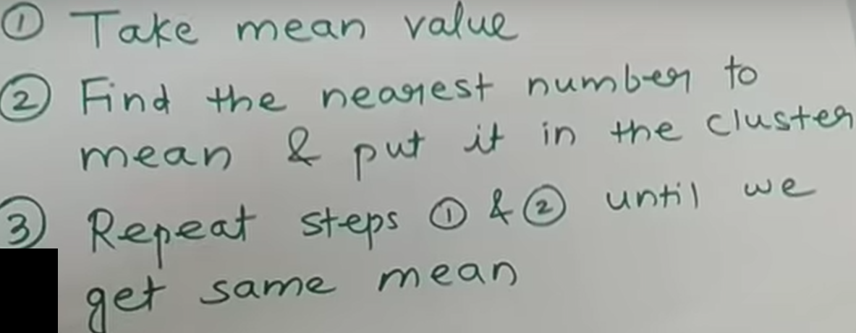
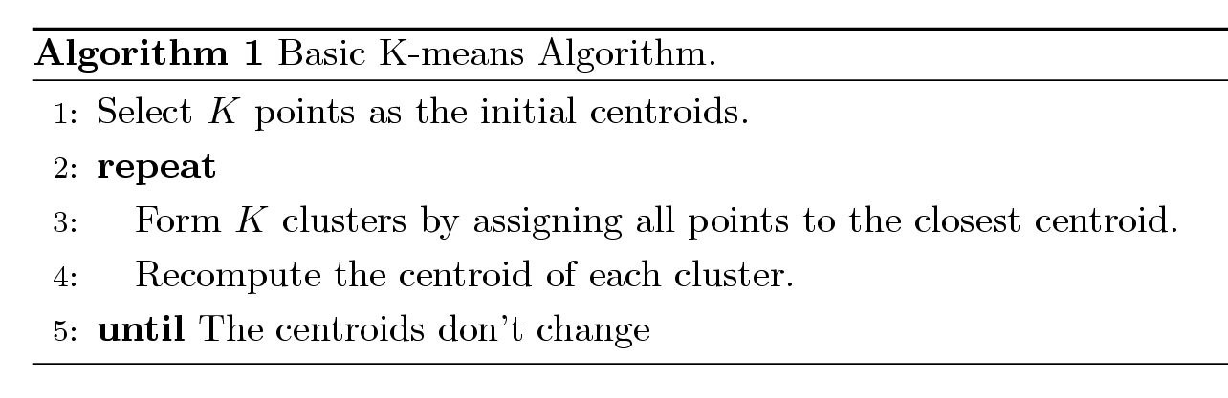
K-means Clustering
Partitional clustering approach
Each cluster is associated with a centroid (center point)
Each point is assigned to the cluster with the closest centroid
Number of clusters, K, must be specified
The basic algorithm is very simple

Slide 33
K-means Clustering – Details
Initial centroids are often chosen randomly.
Clusters produced vary from one run to another.
The centroid is (typically) the mean of the points in the cluster.
‘Closeness’ is measured by Euclidean distance, cosine similarity, etc.
K-means will converge for common similarity measures mentioned above.
Most of the convergence happens in the first few iterations.
Often the stopping condition is changed to ‘Until relatively few points change clusters’
Complexity is O( n * K * I * d )
n = number of points, K = number of clusters, I = number of iterations, d = number of attributes

Slide 34
Two different K-means Clusterings
Original Points
Optimal Clustering
Sub-optimal Clustering

Slide 35
Evaluating K-means Clusters
Most common measure is Sum of Squared Error (SSE)
For each point, the error is the distance to the nearest cluster
To get SSE, we square these errors and sum them.
x is a data point in cluster C_{i} and m_{i} is the representative point for cluster C_{i}
can show that m_{i} corresponds to the center (mean) of the cluster
Given two clusters, we can choose the one with the smallest error
One easy way to reduce SSE is to increase K, the number of clusters
A good clustering with smaller K can have a lower SSE than a poor clustering with higher K

Slide 36
Importance of Choosing Initial Centroids

Slide 37
Importance of Choosing Initial Centroids

Slide 38
Importance of Choosing Initial Centroids …

Slide 39
Importance of Choosing Initial Centroids …

Slide 40
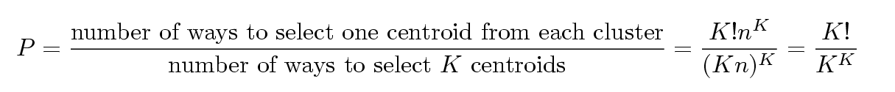
Problems with Selecting Initial Points
If there are K ‘real’ clusters then the chance of selecting one centroid from each cluster is small.
Chance is relatively small when K is large
If clusters are the same size, n, then
For example, if K = 10, then probability = 10!/10¹⁰ = 0.00036
Sometimes the initial centroids will readjust themselves in ‘right’ way, and sometimes they don’t
Consider an example of five pairs of clusters

Slide 41
10 Clusters Example
Starting with two initial centroids in one cluster of each pair of clusters

Slide 42
10 Clusters Example
Starting with some pairs of clusters having three initial centroids, while other have only one.

Slide 43
Solutions to Initial Centroids Problem
Multiple runs
Helps, but probability is not favorable
Sample and use hierarchical clustering to determine initial centroids
Select more than k initial centroids and then select among these initial centroids
Select most widely separated
Postprocessing

Slide 44
Pre-processing and Post-processing
Pre-processing
Normalize the data
Eliminate outliers
Post-processing
Eliminate small clusters that may represent outliers
Split ‘loose’ clusters, i.e., clusters with relatively high SSE
Merge clusters that are ‘close’ and that have relatively low SSE

Slide 45
Variations of the K-Means Method
Most of the variants of the k-means which differ in
Selection of the initial k means
Dissimilarity calculations
Strategies to calculate cluster means
Handling categorical data: k-modes
Replacing means of clusters with modes
Using new dissimilarity measures to deal with categorical objects
Using a frequency-based method to update modes of clusters

Slide 46
Limitations of K-means
K-means has problems when clusters are of differing
Sizes
Densities
Non-globular shapes
K-means has problems when the data contains outliers.

Slide 47
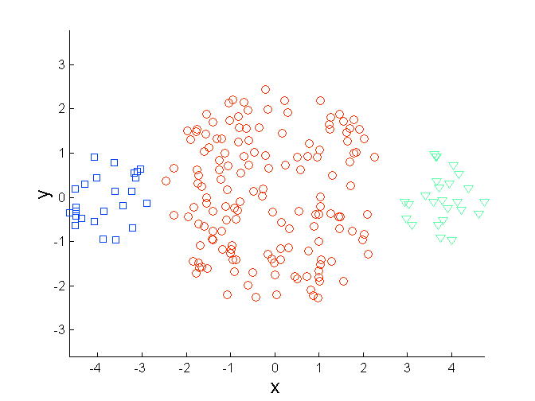
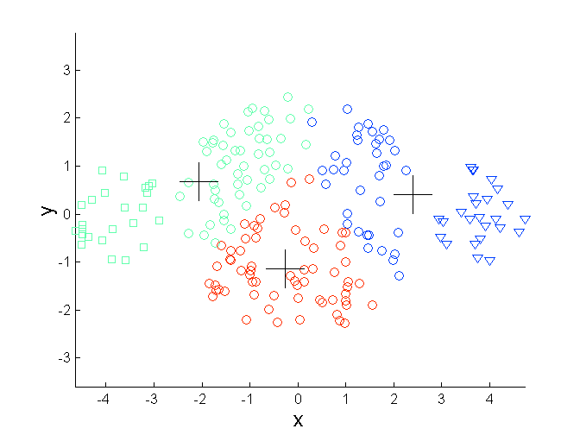
Limitations of K-means: Differing Sizes
Original Points
K-means (3 Clusters)

Slide 48
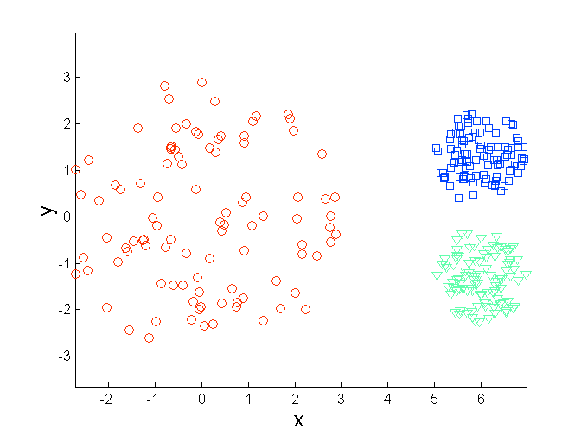
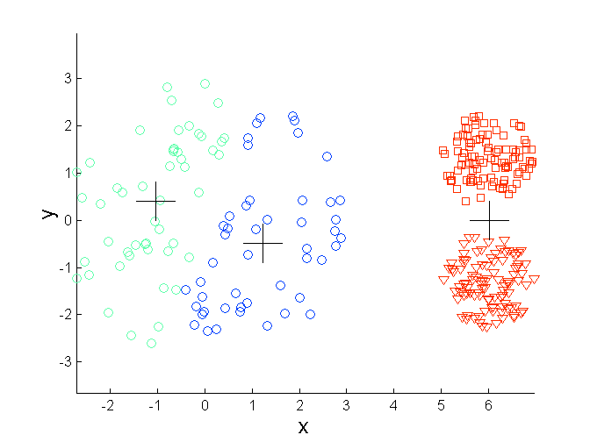
Limitations of K-means: Differing Density
Original Points
K-means (3 Clusters)

Slide 49
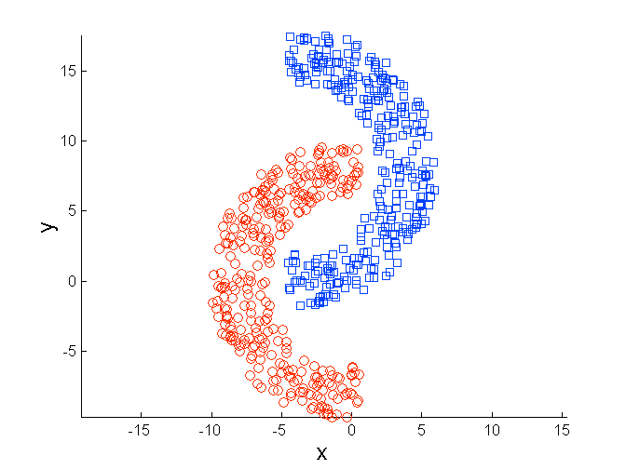
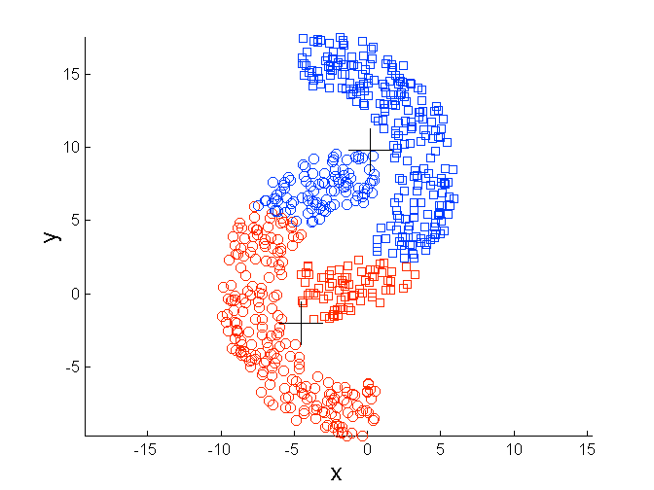
Limitations of K-means: Non-globular Shapes
Original Points
K-means (2 Clusters)

Slide 50
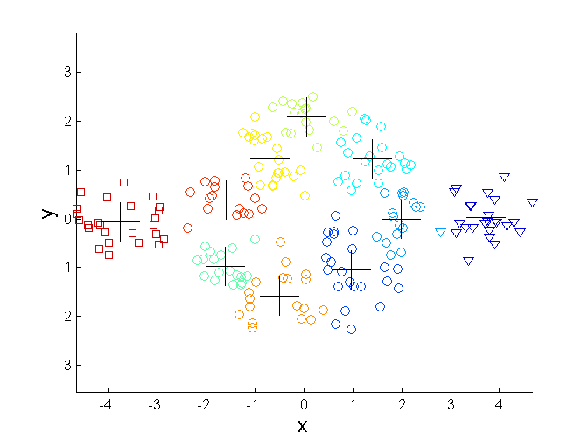
Overcoming K-means Limitations
Original Points K-means Clusters
One solution is to use many clusters.
Find parts of clusters, but need to put together.

Slide 51
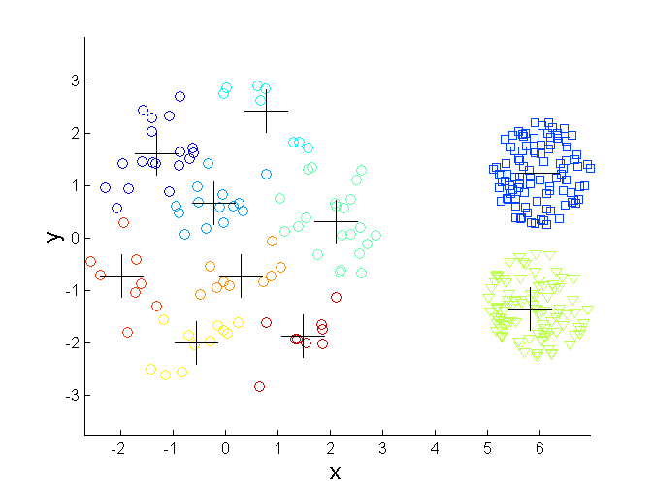
Overcoming K-means Limitations
Original Points K-means Clusters

Slide 52
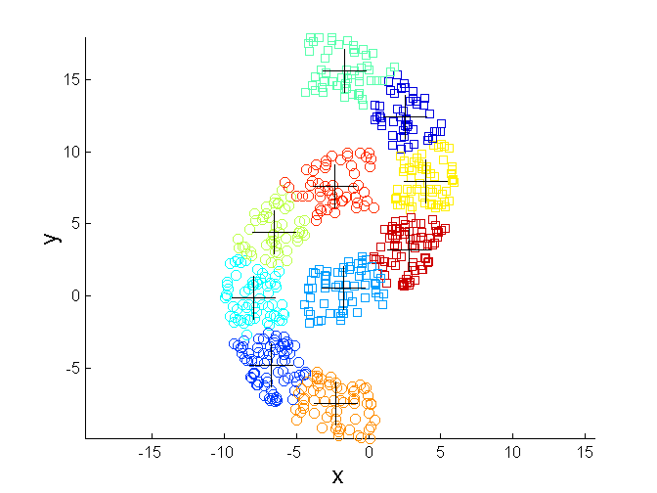
Overcoming K-means Limitations
Original Points K-means Clusters

Slide 53
Comments on the K-Means Method
Strength: Efficient: O(tkn), where n is # objects, k is # clusters, and t is # iterations. Normally, k, t << n.
Comparing: PAM: O(k(n-k)² ), CLARA: O(ks² + k(n-k))
Comment: Often terminates at a local optimal.
Weakness
Applicable only to objects in a continuous n-dimensional space
Using the k-modes method for categorical data
In comparison, k-medoids can be applied to a wide range of data
Need to specify k, the number of clusters, in advance
Sensitive to noisy data and outliers
Not suitable to discover clusters with non-convex shapes

Slide 54
The K-Medoid Clustering Method
K-Medoids Clustering: Find representative objects (medoids) in clusters
PAM (Partitioning Around Medoids)
Starts from an initial set of medoids and iteratively replaces one of the medoids by one of the non-medoids if it improves the total distance of the resulting clustering
PAM works effectively for small data sets, but does not scale well for large data sets (due to the computational complexity)
Efficiency improvement on PAM
CLARA : PAM on samples
CLARANS : Randomized re-sampling

Slide 55
Prescribed Text Books
 | Author(s), Title, Edition, Publishing House
T1 | Tan P. N., Steinbach M & Kumar V. “Introduction to Data Mining” Pearson Education
T2 | Data Mining: Concepts and Techniques, Third Edition by Jiawei Han, Micheline Kamber and Jian Pei Morgan Kaufmann Publishers
R1 | Predictive Analytics and Data Mining: Concepts and Practice with RapidMiner by Vijay Kotu and Bala Deshpande Morgan Kaufmann Publishers
R2 | Oracle Documentation (http://docs.oracle.com/cd/B28359_01/datamine.111/b28129/regress.htm)

Slide 56
Thank You

Slide 57
Updated slides to include an example of HAC

Slide 58
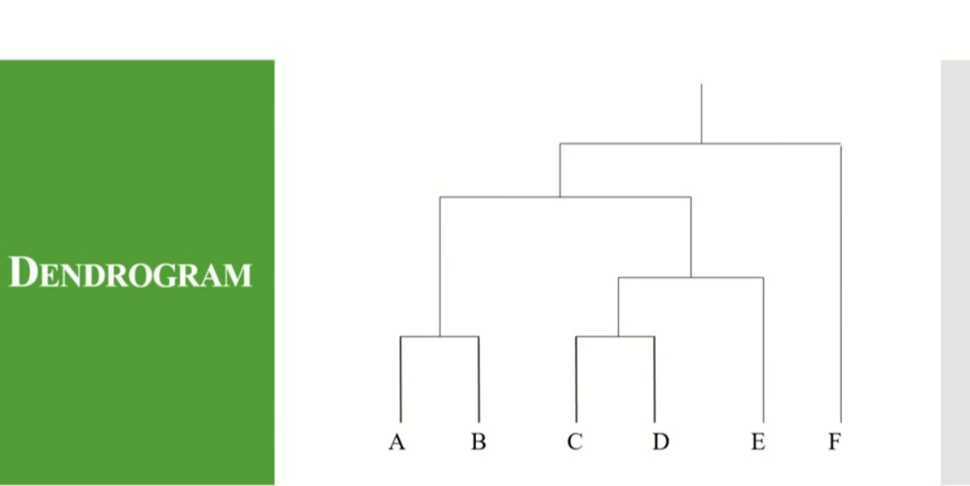

Slide 59
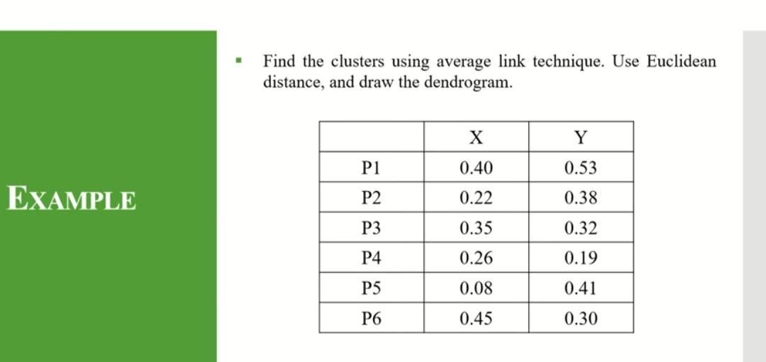

Slide 60
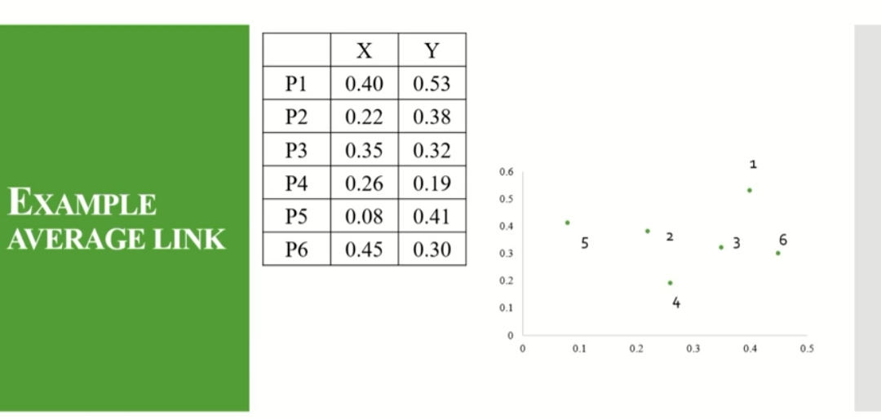

Slide 61
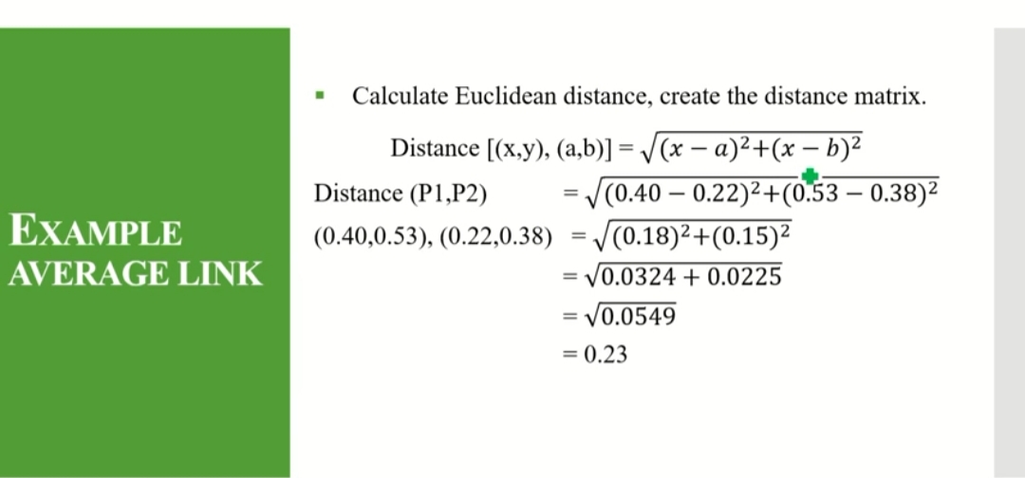

Slide 62
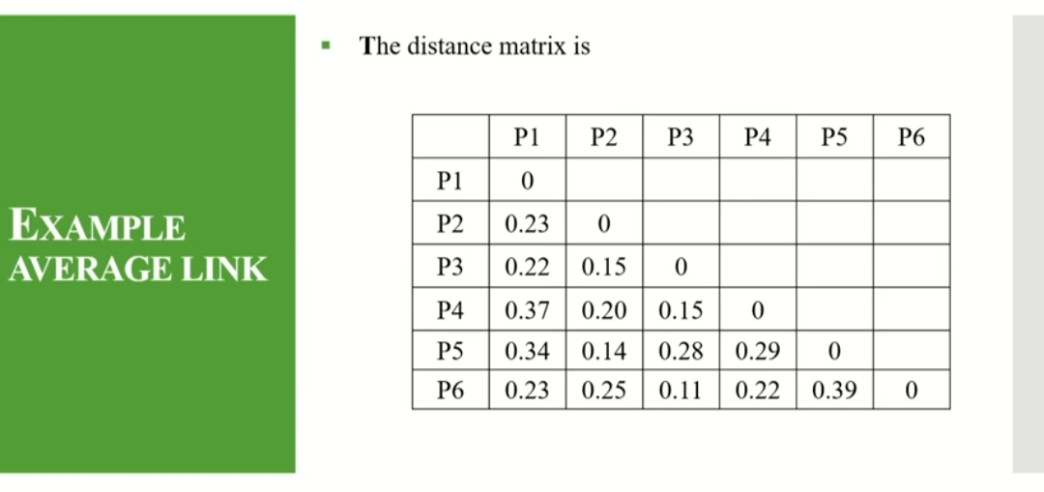

Slide 63
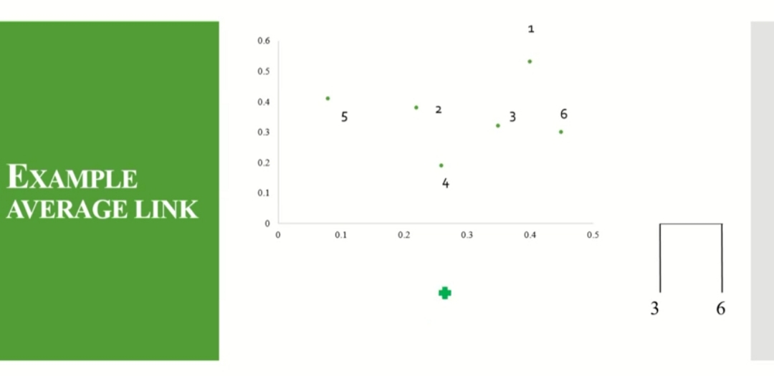
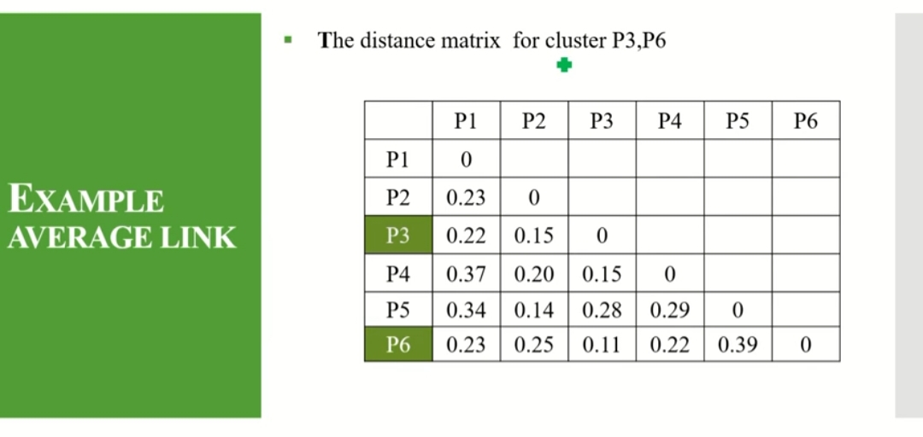

Slide 65
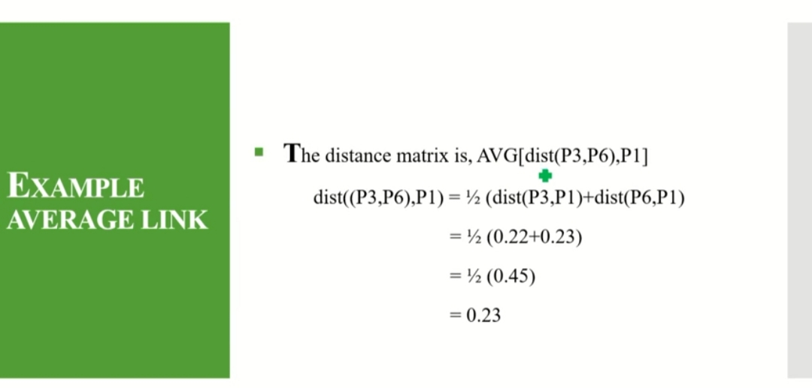

Slide 66
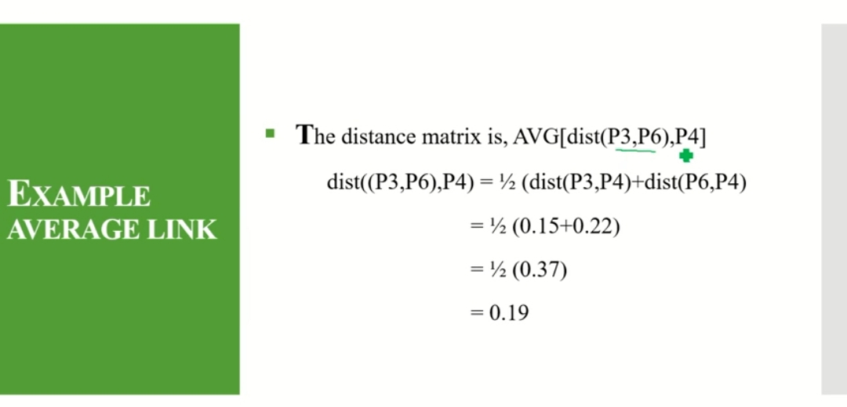

Slide 67
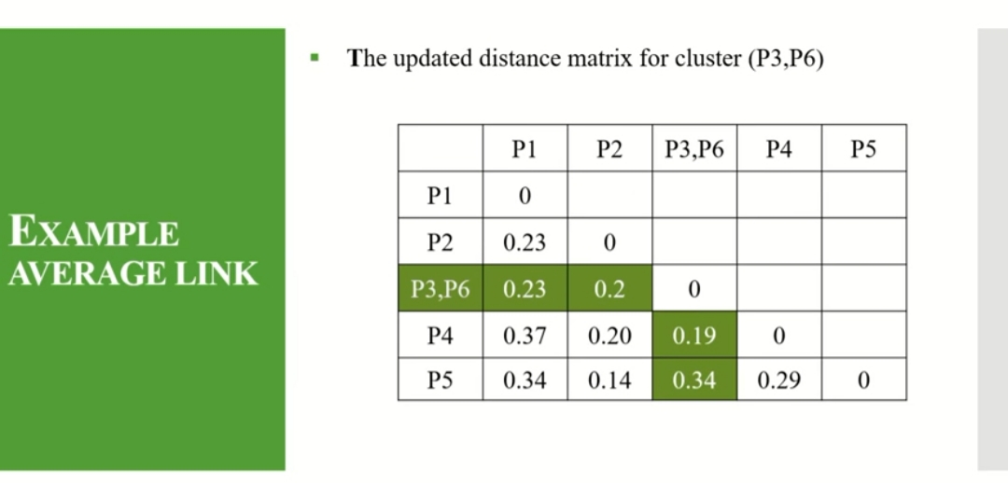

Slide 68
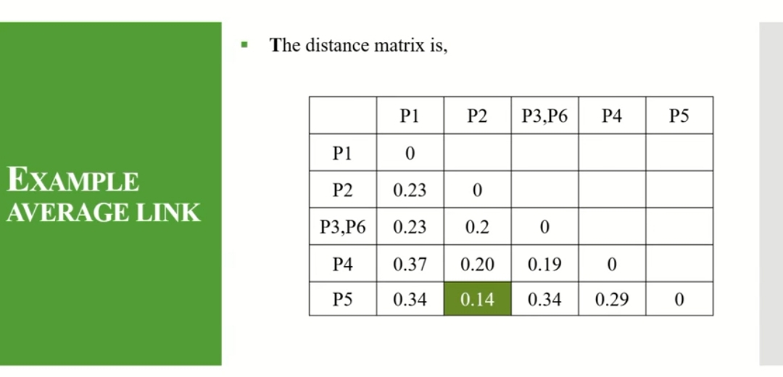

Slide 69
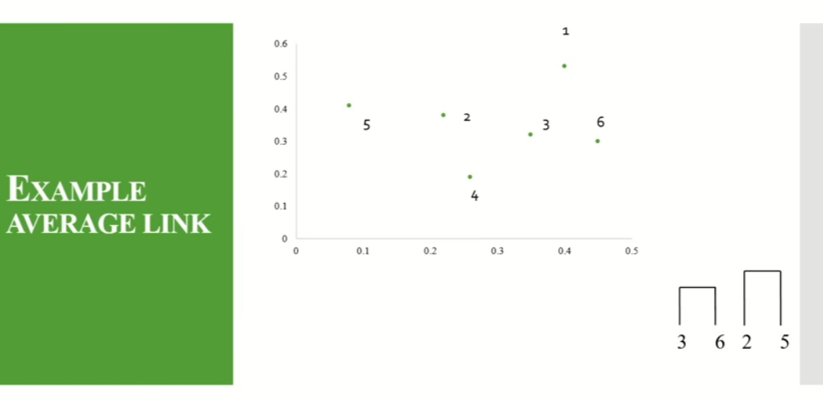

Slide 70
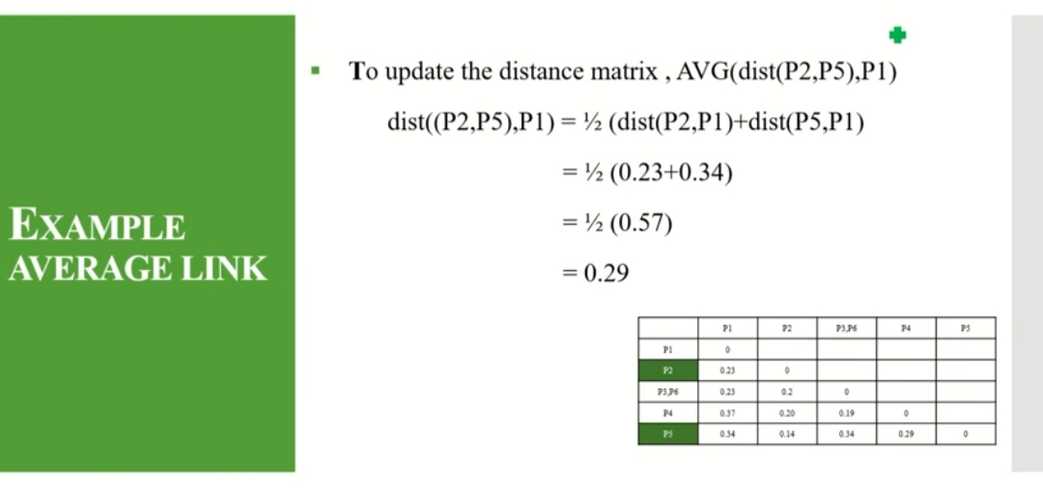

Slide 71
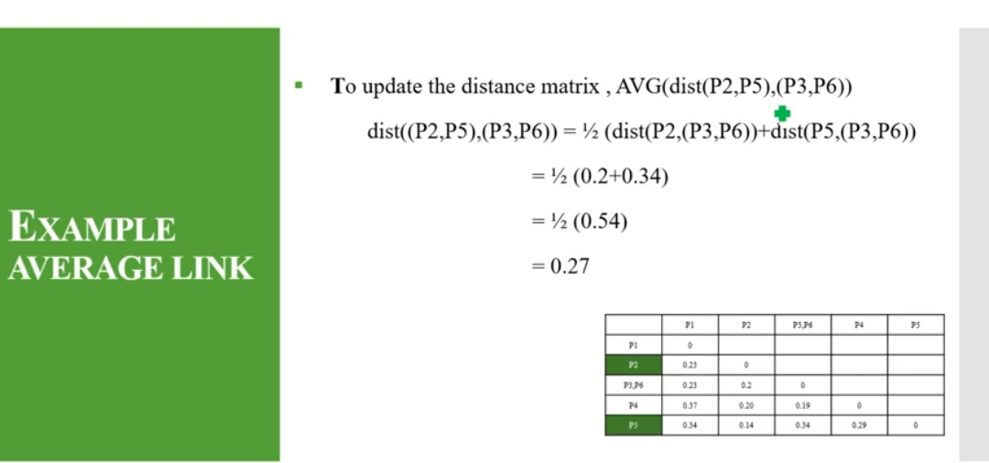

Slide 72
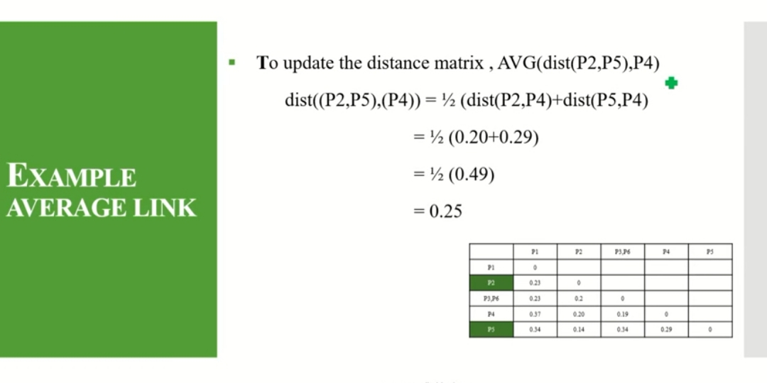

Slide 73
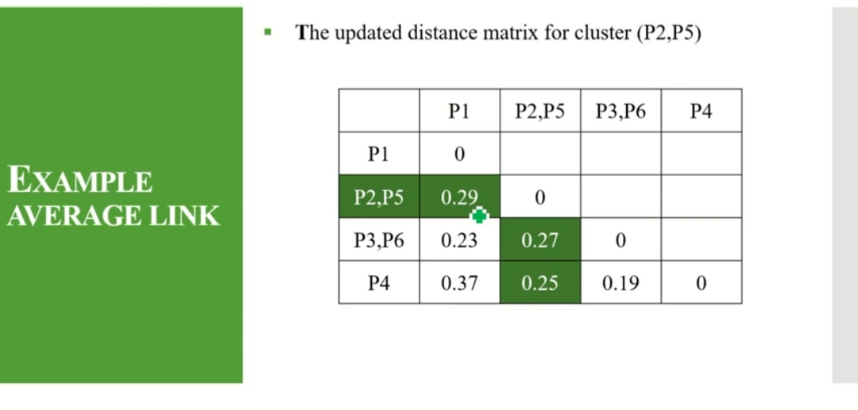

Slide 74
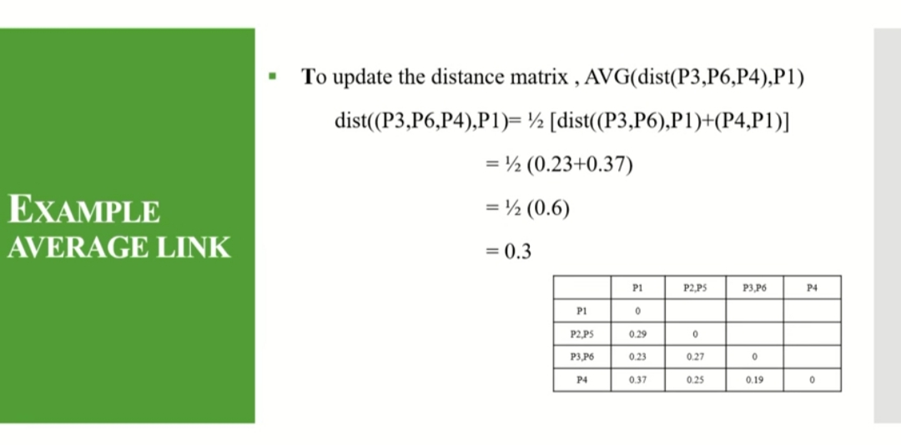

Slide 75
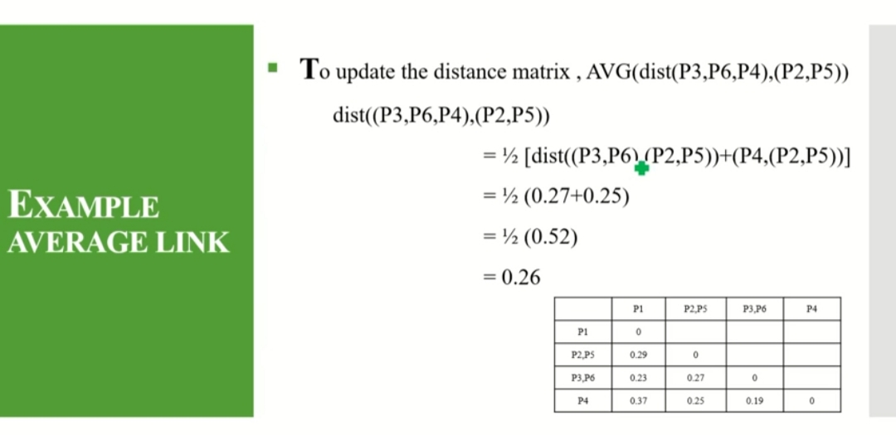

Slide 76
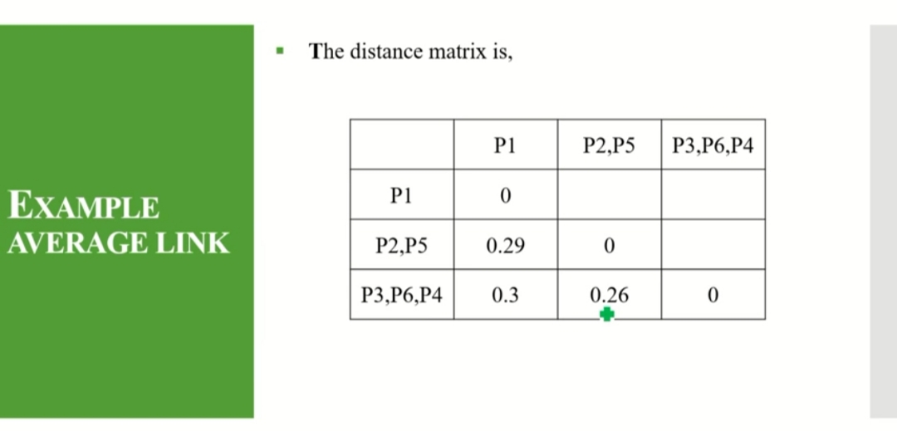

Slide 77
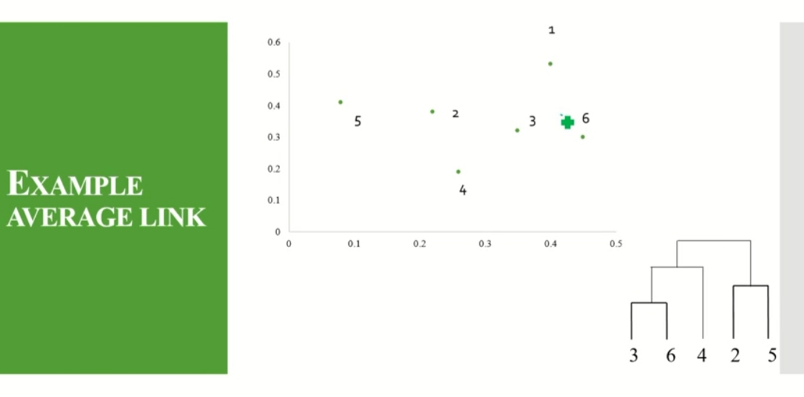

Slide 78
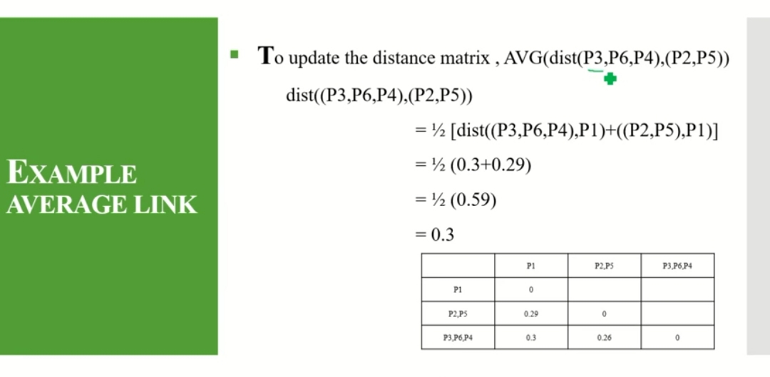

Slide 79
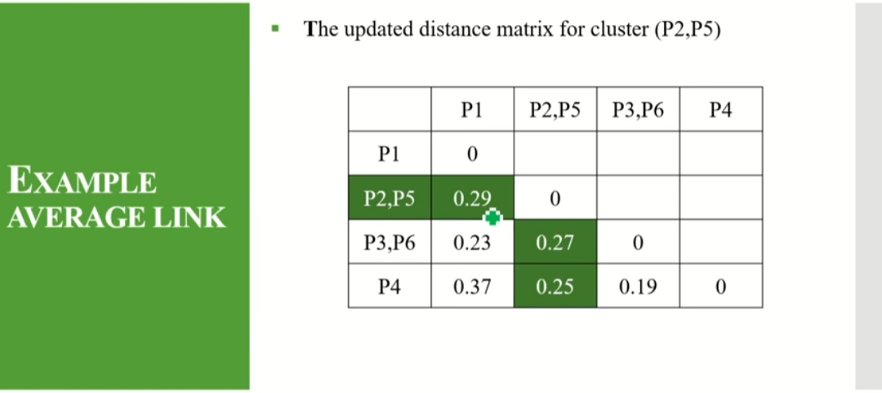

Slide 80
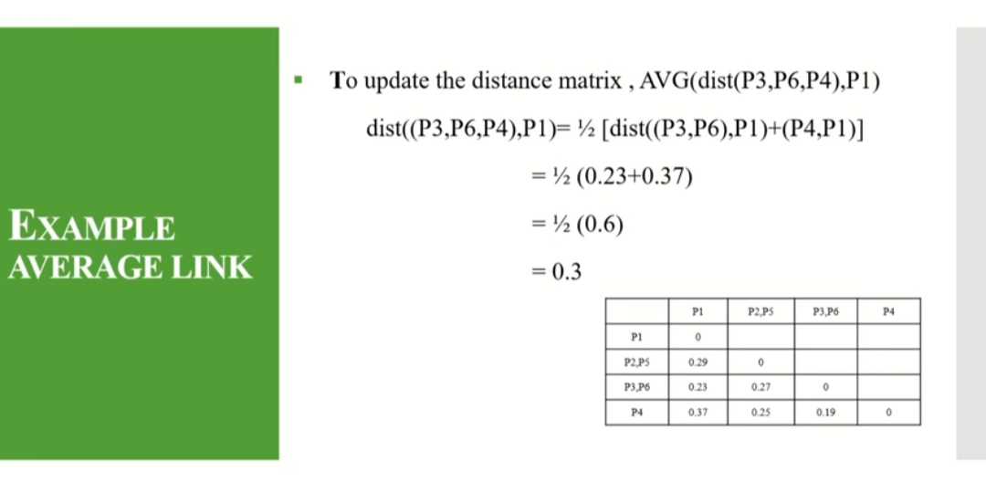

Slide 81
REFER: FILES FOLDER FOR SESSION-9 AND SESSION-10 FILES https://bits-pilani.instructure.com/groups/4533/files/folder/AllFilesForDownload/Session%209%20and%20Session%2010
Q & A

